Slide 1
Battle of the Cities
IBM's Applied Data Science Capstone online course via Coursera
Paige Larsen

Slide 2
Introduction
Audience: upcoming data scientists looking for a career at IBM’s headquarters in Armonk, NY
Assistance with preferable city selection for new home
Cities within reasonable commute
Local venues and venue types
Lifestyle preferences
Cities grouped by most common nearby venue type
Recommendations provided based on lifestyle preferences

Slide 3
Data
FreeMapTools
Cities within 35-mile commute of Armonk, NY
BeautifulSoup & Wikipedia
Population data of cities within 3 neighboring states
Geocoder Package Using ArcGIS
City coordinate retrieval
Foursquare API
Amount and type of local city venues

Slide 4
Methodology
1) Determine cities within 35-mile commute and combine with “cities” of 20,000 or greater population (as of 2010)
2) Retrieve city coordinates and map city locations
3) Discover 100 most common nearby venue types within half mile of cities
4) Examine cities with 10 or less nearby venues, then re-map and re-run Foursquare code
5) Cluster cities by most common venue type via k-Means and analyze

Slide 5
Analysis
Exploratory analysis
Investigate why cities appear duplicate times
Explore cities’ common nearby venues data
Examine and tweak city coordinates with few nearby venues
k-Means clustering
Determine optimal k via elbow method
Cluster cities based on most common venue types
Visualize clusters via mapping
Look for patterns across clusters

Slide 6
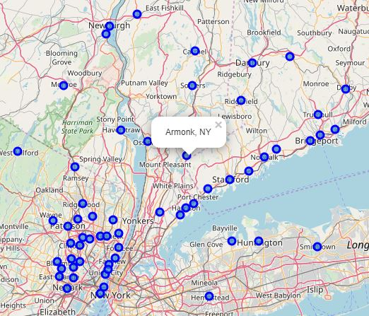
Location of Nearby Cities
60 cities displayed across 3 states (NY, CT, NJ)
Within 35-mile commute of IBM’s headquarters in Armonk, NY
Cities with non-accurate location data were tweaked prior to this screenshot

Slide 7
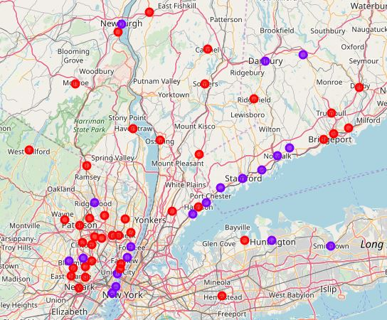
Clusters of Nearby Cities
Cluster 0 cities are in red
Cluster 1 cities are in purple
Cluster 0 cities appear in more inland, congested areas
Cluster 1 cities appear more along the coastline

Slide 8
Results and Discussion
k-Means clusters appear to have no pattern via most common nearby venue types
High number of pizza places, Italian restaurants, and American restaurants in both
Clusters appear to have been location-based instead
Cluster 0: inland, congested areas
Cluster 1: cities along shorelines
Recommend: data scientists who prefer to eat out and reside in populated areas look into nearby cities
Recommend: for those who do not, consider other work locales while conducting more research

Slide 9
Conclusion
Examined populated cities within a commutable distance of IBM’s headquarters
Looked at most common nearby venue types to determine optimal living places
Ultimately found cities held similar fast food venues
k-Means clusters appeared more spatial-based instead of venue-based
Upcoming data scientists have the final say on where to live
Of course, more factors to consider than those mentioned
But this project can help make it easier for data scientists to decide

Slide 10
Acknowledgements
Stack Overflow
IBM's Data Science Professional Certificate Courses
FreeMapTools
https://chrisalbon.com/python/data_wrangling/pandas_join_merge_dataframe/
https://blog.floydhub.com/introduction-to-k-means-clustering-in-python-with-scikit-learn/
https://www.scikit-yb.org/en/latest/api/cluster/elbow.html
https://joernhees.de/blog/2015/08/26/scipy-hierarchical-clustering-and-dendrogram-tutorial/

